Slide 1
ARTICLE ID = ICEARS123
PROJECT TITLE
HYBRID NOISE REDUCTION AND ENHANCEMENT OF AUDIO QUALITY USING DEEP LEARNING
PRESENTED
BY
MAHAN.K
AUTHORS
K.MAHAN, M.LIBINA

Slide 2
ABSTRACT
This project aims to reduce noise and improve the quality of the audio by using Noise cancellation techniques such as Adaptive filter and NLMS algorithms and these algorithm takes more time to process the output so that by using deep learning techniques such as CNN is used to minimize the process and improve the performance of the noise cancellation project. The CNN includes Keras, Tensolflow to build layers of tasks to make the training model easy to process with the preprocessed dataset.

Slide 3
INTRODUCTION
Audio signals are often degraded by various types of noise, such as background noise, static, and interference, which can negatively impact the quality and clarity of the signal.
This is especially problematic in fields such as speech processing, music production, and audio communication.
Deep Learning provides a promising solution to this issue through its ability to learn complex patterns in data and make accurate predictions.
A Deep Learning approach is used to ease the process of noise cancellation and help improving the existing algorithm in this project.

Slide 4
EXISTING SYSTEM
The existing system approaches for audio noise removal typically rely on signal processing techniques such as adaptive filter algorithm, Frequency domain and time domain approach.
These methods can effectively reduce some types of noise, but they often struggle with more complex and varying types of noise, such as non-stationary and overlapping noise.
Additionally, these methods can introduce unwanted artifacts into the clean signal and are computationally intensive, making them less suitable for real-time applications.
As a result, there is a need for a more effective and efficient solution to audio noise removal.

Slide 5
DISADVANTAGES
Inadequacy for complex noise: Traditional methods are often unable to effectively remove complex and varying types of noise, such as non-stationary and overlapping noise.
Computational Intensity: Traditional methods can be computationally intensive, making them less suitable for real-time applications.
Limited ability to learn: Traditional methods are rule-based and do not have the ability to learn from data and improve their performance over time.
Lack of generalization: Existing methods are often designed for specific types of noise, which limits their ability to generalize to new and unseen types of noise.

Slide 6
PROPOSED SYSTEM
The proposed system uses NLMS algorithm and deep learning techniques such as keras are used to train the model that aims to improve the performance of adaptive filter techniques for Noise Cancellation by addressing issues such as self-tuning of the parameter, using standard databases for comparison, reducing convergence time, improving all performance measures, and minimizing computational complexity.
The proposed system will involve a comprehensive analysis of existing adaptive filter algorithms for Noise Cancellation systems and a study of their performance under different noise conditions. Additionally, the research will focus on developing refined adaptive filter algorithms for both correlated and uncorrelated noise components to improve the overall performance of the Noise Cancellation system.

Slide 7
ADVANTAGES
Effectiveness for complex noise: The deep learning approach can effectively remove complex and varying types of noise, such as non-stationary and overlapping noise.
Minimal artifacts introduction: The deep learning approach can produce a cleaner output signal with minimal artifacts, preserving the quality and clarity of the signal.
Efficient and real-time capable: The deep learning approach is computationally efficient, making it suitable for real-time applications.
Ability to generalize and improve: The deep learning approach can generalize to new and unseen types of noise and can continue to improve its performance through fine-tuning and retraining.
Notes:
(i.e. Partsof-Speech features, Linguistic and Word Count features and Sentimental Content features)

Slide 8
ARCHITECTURE
Pre-Processing
(Librosa, NLMS Algorithm)
Design CNN Architecture
(Keras, Tensorflow)
Testing the Model
Raw Data (Input audio)
Training the Model
Clean Audio
Pre-Processing
Compiling the Model
(CNN)
Dataset (RAVDESS)

Slide 9
DATASET
The RAVDESS dataset consists of audio recordings of actors speaking and singing in various emotions, providing a diverse and rich dataset for audio processing tasks.
The RAVDESS dataset can be used for training and evaluating the audio noise removal model, as it contains speech and singing signals with different levels of noise, making it suitable for the task.
The RAVDESS dataset can be used as input to the model during training, and its clean audio signals can be used as ground-truth labels. During evaluation, the model can be tested on the RAVDESS dataset to assess its performance on real-world audio signals.

Slide 10
PRE-PROCESSING
The raw audio signals are first pre-processed using the Librosa library. This involves resampling, normalization, and segmentation of the signals into shorter segments.
The Normalized Least Mean Squares (NLMS) algorithm is an adaptive filter algorithm used for various signal processing applications such as noise cancellation, echo cancellation, and channel equalization.
It is a popular algorithm due to its simplicity, low computational complexity, and effectiveness in reducing the noise from the signal.
The algorithm estimates the weights of the adaptive filter by minimizing the mean square error between the filter output and the desired signal.

Slide 11
DESIGNING CNN ARCHITECTURE
By using the Keras to built the architecture of the CNN, including the number of layers, the type of layers, and the number of filters in each layer.
Using TensorFlow as the backend: Set TensorFlow as the backend for Keras, which allows the CNN to be run on the TensorFlow platform for efficient training and inference.
By using Keras and TensorFlow to design and train the CNN, the model can be optimized for the specific requirements of the audio noise removal task, and its performance can be improved.

Slide 12
COMPILING THE MODEL
Define the loss function: Choose a suitable loss function, such as mean squared error or mean absolute error, to measure the difference between the predicted and actual outputs.
Select the optimization algorithm: Choose an optimization algorithm, such as stochastic gradient descent or Adam, to minimize the loss function and update the model weights.
Compile the model: Use the Keras to compile the model, specifying the loss function, optimization algorithm, and metrics to be used during training and evaluation.

Slide 13
MODEL TRAINING
Select the number of layers: Decide on the number of layers in the CNN, considering the complexity of the task and the size of the dataset.
Choose the type of layers: Select the type of layers to use in the CNN, such as convolutional, and dense layers, based on the specific requirements of the task and the desired performance.
Determine the number of filters: Specify the number of filters in each layer, which determine the number of features that the CNN will learn.

Slide 14
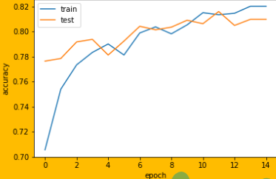
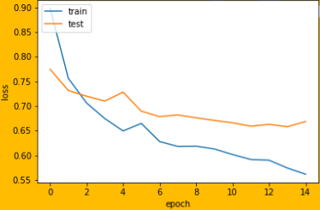
OUTPUT SCREENSHOT
Accuracy prediction
Loss prediction

Slide 15
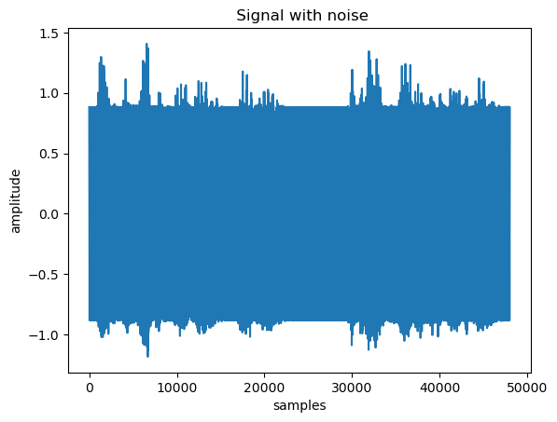
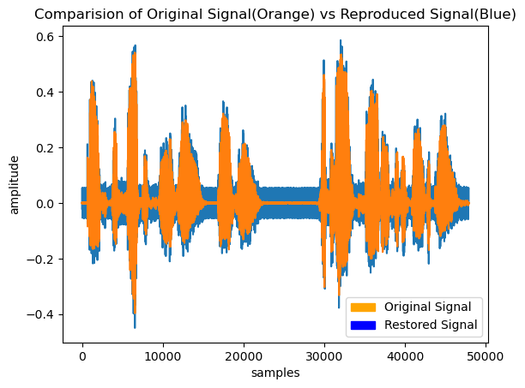
Audio with noise
Clean audio

Slide 16
CONCLUSION
In conclusion, the study on Noise Cancellation in speech signals presents various adaptive algorithms, including LMS, NLMS, and RLS, which have their own advantages and limitations. The aim of these algorithms is to achieve maximum PSNR, minimum misadjustment, and fast convergence with minimum computational complexity. However, the study suggests refining the existing NLMS algorithm to enhance its performance. Moreover, the study highlights the importance of choosing the step size intelligently, which requires multiple trials of the simulation, and the filter length, which is a crucial parameter that affects the performance of ANC in different noisy environments. Overall, this study emphasizes the need for further research in the field of ANC to improve the performance of adaptive algorithms and overcome their limitations.

Slide 17
THANK YOU!

